Slide 1


iMatch-IT
Dr. Arun Aryal
Spring 2020
CIS 5040 - Information Systems
Ramella Talverdi | Ninilia Talverdi | David Gómez Tagle | Saba Rehman | Jhanavi Oza

Slide 2
Problem
Shopping via mobile apps is becoming increasingly important. Convenience and price comparison are the main drivers. Most of the time women have difficulty to find matching clothes and accessories for certain occasions or they don’t know how clothes will fit them. iMatch-IT has a solution!

Slide 3
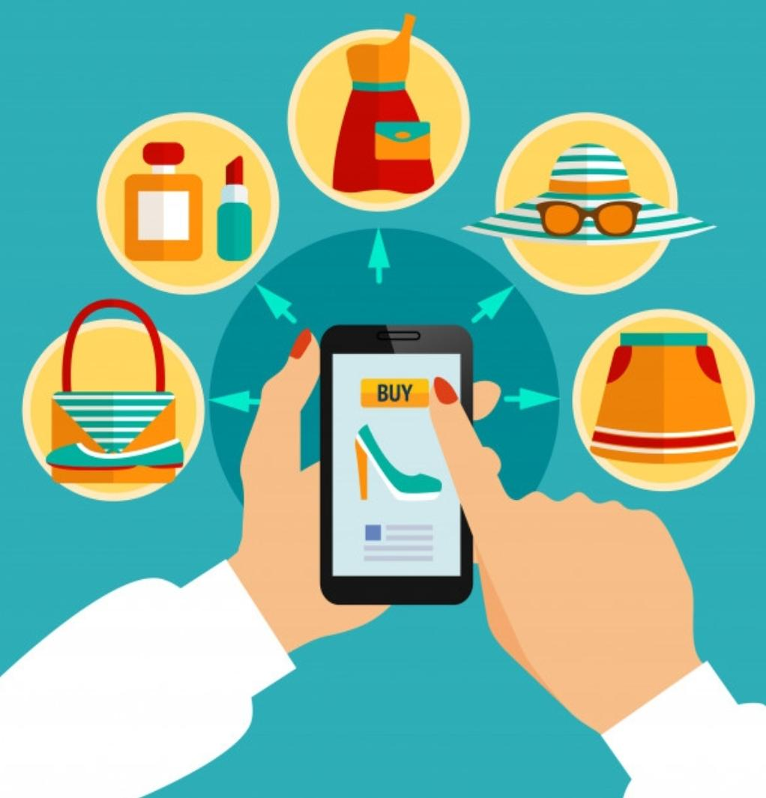
Objective
Personalizing the shopping
experience by
Designing an application for women which matches outfits and accessories

Slide 4
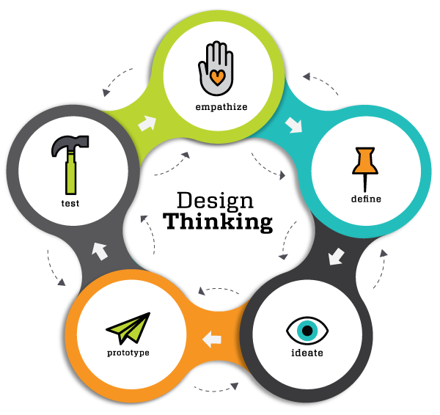
Design Thinking Phases

Slide 5

EMPATHIZE
Market research
Design research
Seek to understand

Slide 6

Research Overview
Total Surveys Taken: 77
Total Interviews Taken: 12
Notes:
https://forms.gle/W5pW1rv5X2Eqcc3u8

Slide 7
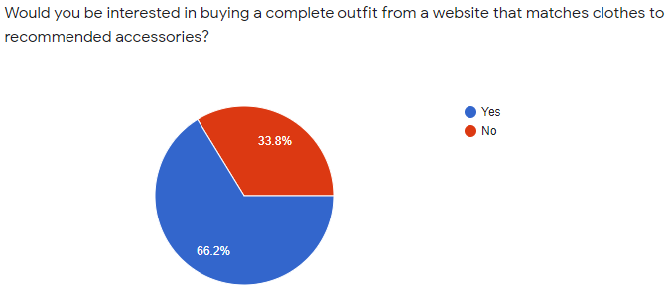
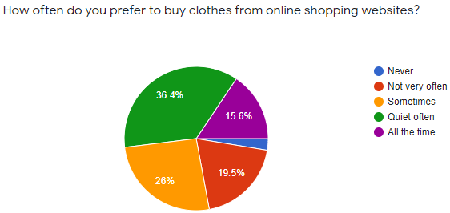
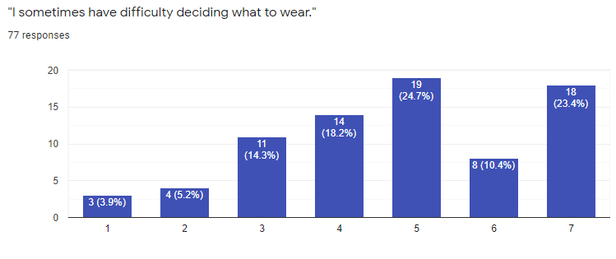
Statistics from Surveys
Interested in online shopping
Using a fashion app

Slide 8
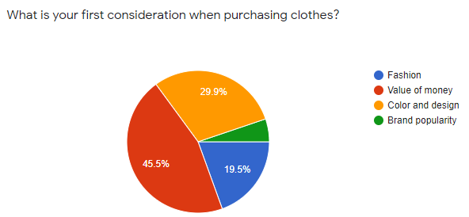
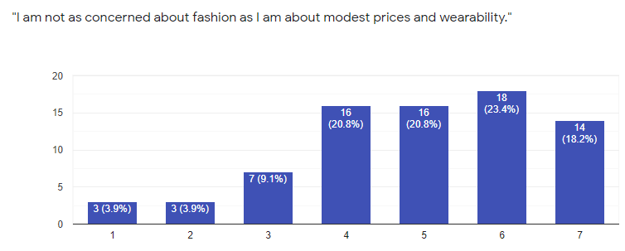
Statistics from Surveys
Importance of Price

Slide 9
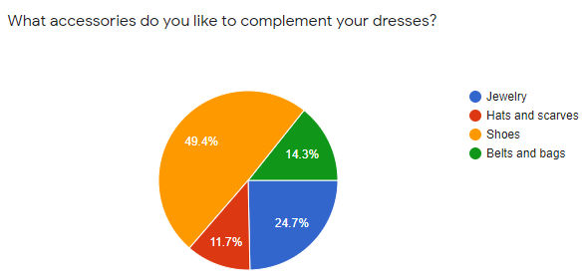
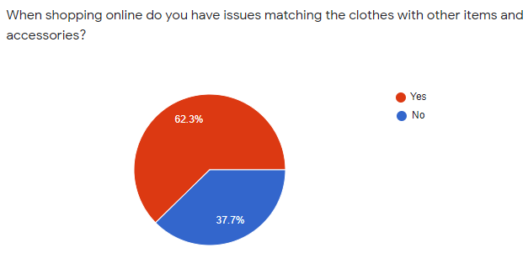
Statistics from Surveys
Matching outfit with accessories

Slide 10

DEFINE
Analyze data
Create personas
Identify role objectives
Understand pain points

Slide 11
Defining Our Users
Understanding our users’ needs
“What are your goals? What are your plans?”
Learning from their history
“How do you typically do your clothing shoppings?”
Looking at the context
“What are some things preventing you from successful shopping?”
using Thick Data (Qualitative Data)

Slide 12

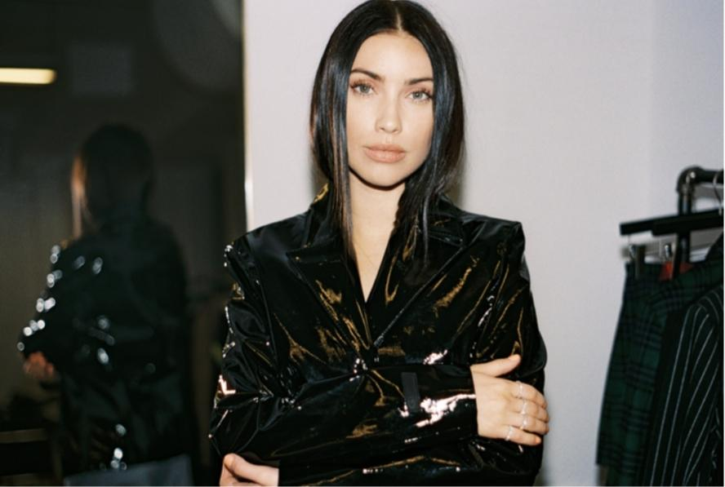
User Personas
Isabella James
Valentina Ricci
Age: 32
Work: Product Manager
Family: Married, No kids
Location: San Diego
Character: Dynamic
Age: 29
Work: Fashion Designer
Family: Single
Location: Pasadena
Character: Static
“It’s SO difficult to find matching Outfits.”
“Fashion is Everything.”
Goals:
Would like to purchase several suits to fit occasion, style and color
Reduce the amount of time and money to dress up
Goals:
Successful designers make predicting consumer trends a primary objective in their work.
Frustration:
Ability to find matching outfits for her meetings easier and faster
The current online shopping solutions do not offer the way the item fits.
Frustration:
Providing quality fashion at an affordable price
Providing different stream lines and platforms to market her designs

Slide 13
What did we learn about our users?
“What are your goals? What is the plan?”
Reduce the amount of time and money spending on shoppings.
“How do you typically do your clothing shoppings?”
Usually doing online shopping.
“What are some things preventing you from successful shoppings?”
Unable to find matching outfits, as well as quality fashion at an affordable price

Slide 14

IDEATION
Share ideas
Brainstorming
Prioritize

Slide 15
“Come up with more creative ideas”
I
I
Ideas
Application that will help the customer to find a “hunt” item. For example, a customer sees a picture of a dress in the internet but she doesn’t know what brand it is. The app gives the option o the customer to post the picture and community members can help each other to find the brand.
Application that shows customers pictures of different people wearing the same item with different accessories.
Application that gives the customers the option to design their favorite clothes. Based on those designs the app will suggest the customer similar items available.
Application, which will give the customer the “Free Try on” option, so that the customer could buy the item and return it for free in case she didn’t like the quality, the fabric,... or if it didn’t fit well.
Application, which shows customer what other people located at the same area the customer lives, wear in a certain temperature.

Slide 16
Clustering the ideas
Pictures of different styles on different people
Pictures of particular styles on different body figures
Pictures of different accessories matched with clothes
Access to hundreds of items worldwide
Access to affordable brands
Access to selling second hand accessories
Ability to design your favorite item
Ability to find your “Hunt” item
Ability to match clothes for a particular occasion
Ability to match accessories
Community members
Personal fashion consultant
24/7 customer service
Free “Try on” option
Free shipping
Free returns

Slide 17

PROTOTYPE
Pick one idea
Build mockups
Iterate quickly

Slide 18
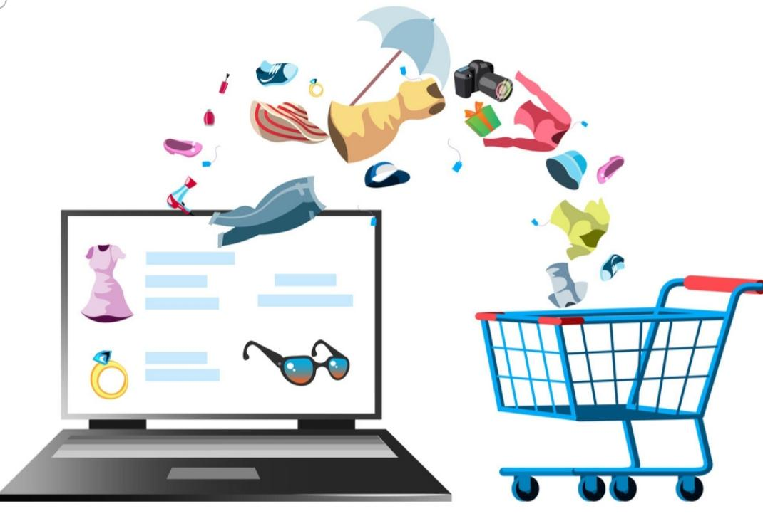
Style assisting
The idea that iMatch-IT group wants to explore and implement is designing an app that focuses on shopping efficiency and convenience.
It will offer bunch of affordable outfits and accessories.
It will match outfits and accessories for customers.
It is a fashion app with selling accessories functionality.
It will save customers time and money.

Slide 19

Design of the application
Balsamiq mockups

Slide 20
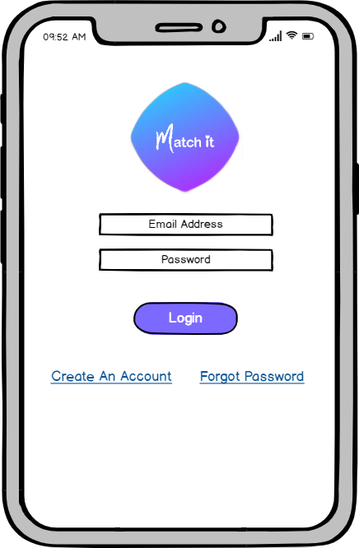
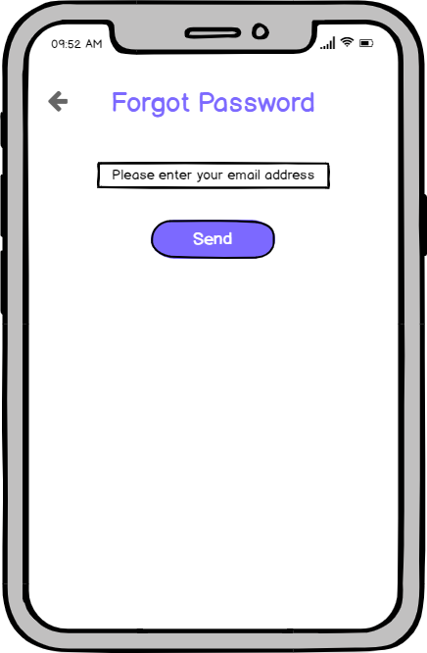
Login

Slide 21
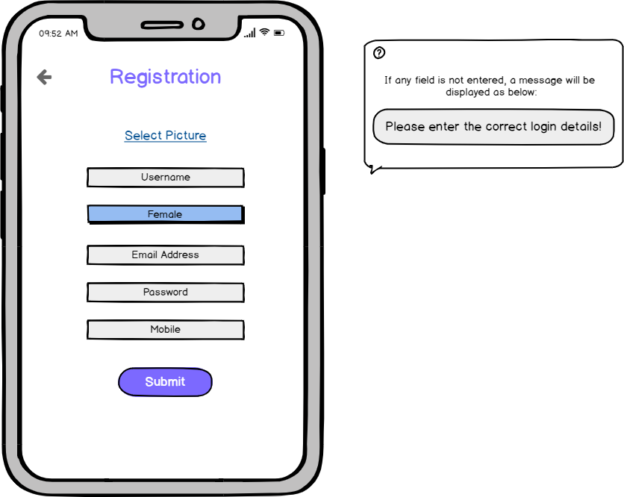
Registration

Slide 22
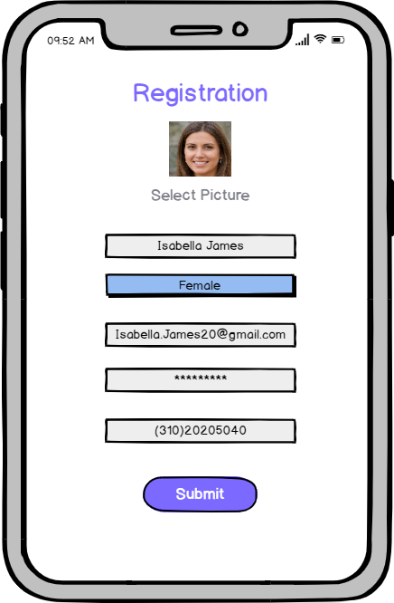
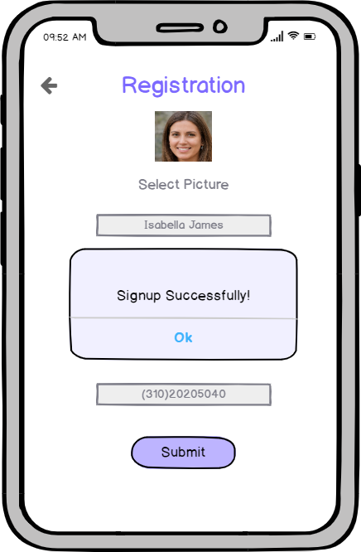
Successful Registration

Slide 23
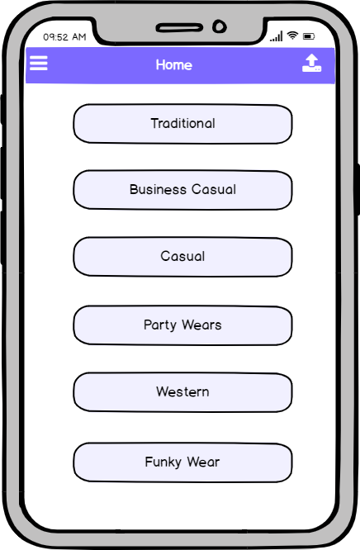
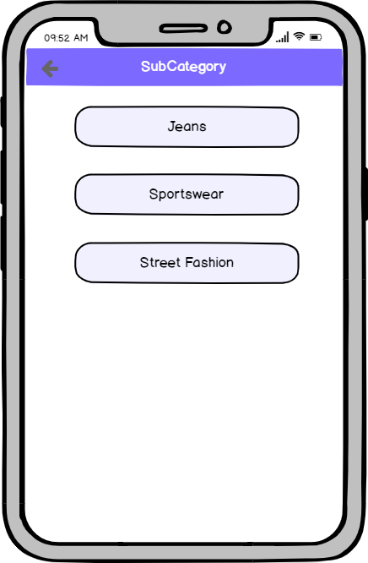
Categories & Subcategories

Slide 24
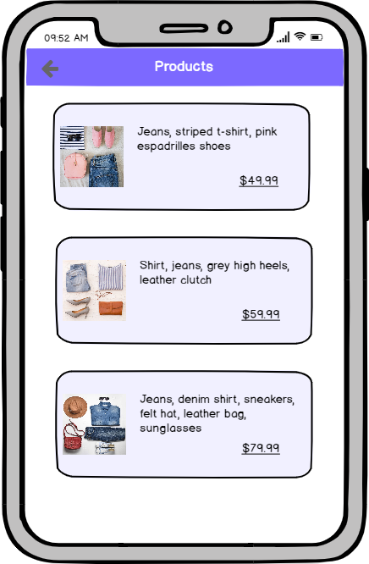
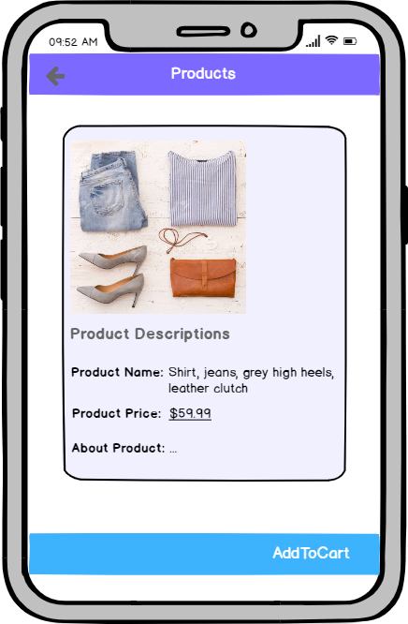
Products List & Product

Slide 25
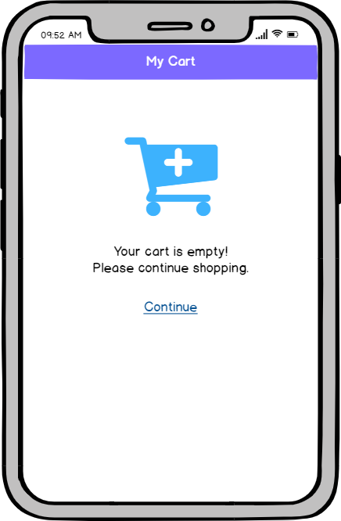
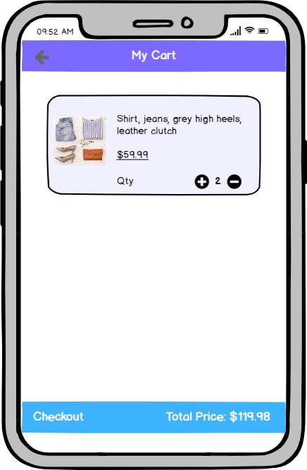
Cart

Slide 26
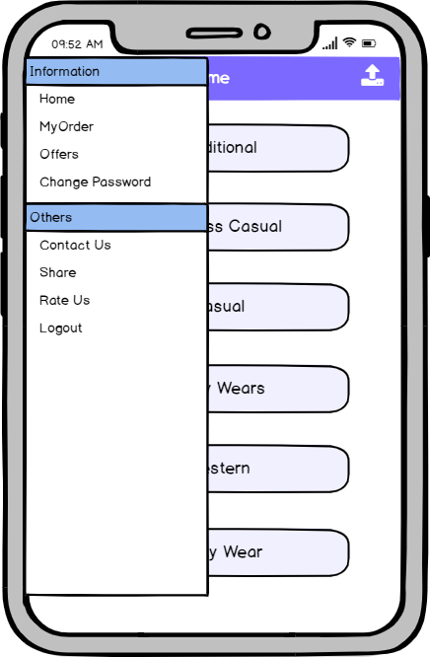
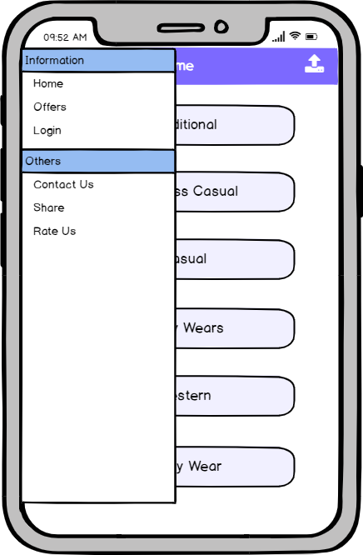
Sidebar Menu

Slide 27
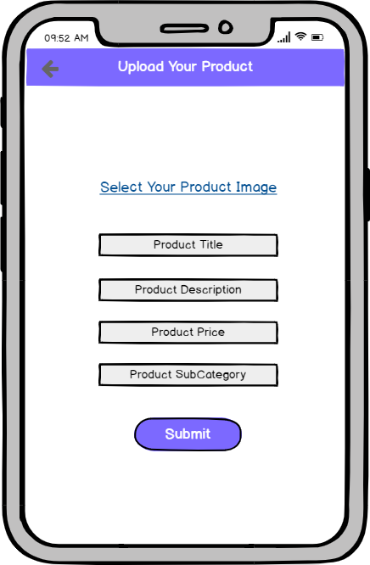
Upload Product

Slide 28
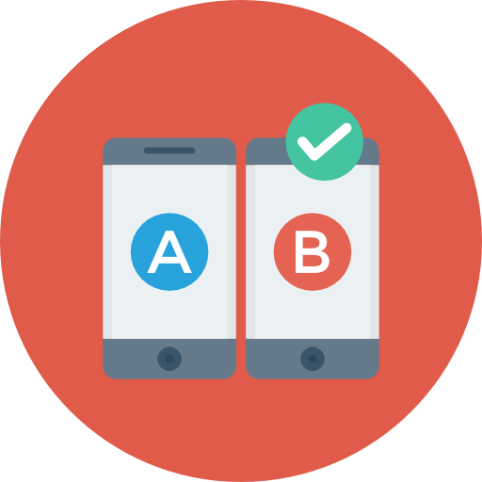
TEST
Implement and test
Get customer feedback
Iterate quickly

Slide 29
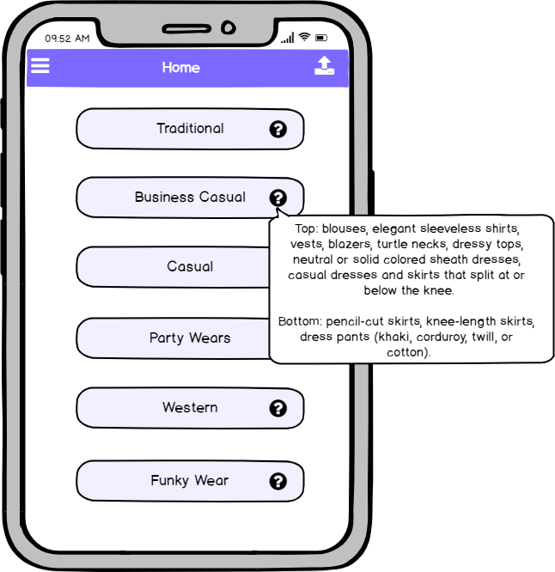
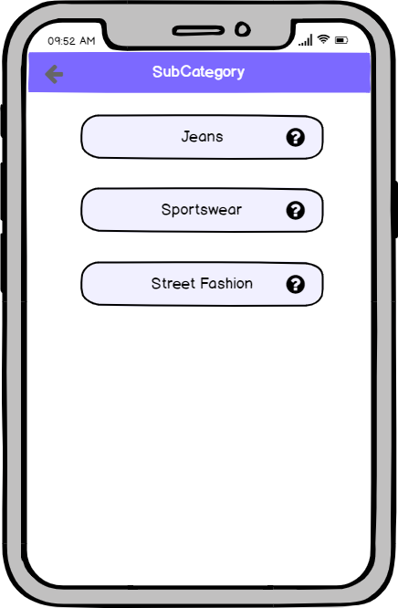
Improve Categories & Subcategories

Slide 30
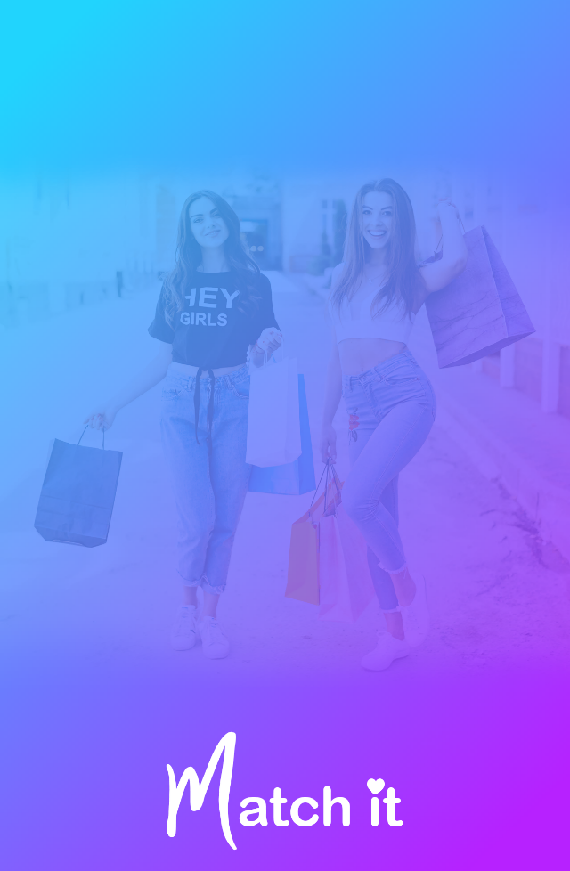
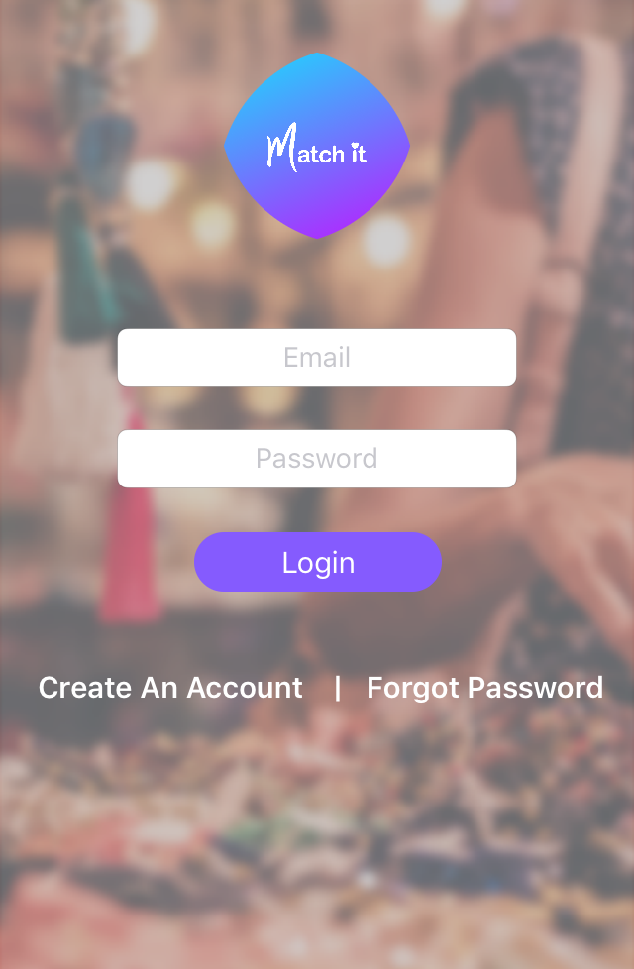
Implementation of the application

Slide 31
iMatch-IT
Thank you
Let Us Style You!

